Slide 1
Minor Project Presentation
Title : Enhancing Biometric Security using Homomorphic Encryption
By Vikas Kumar Saini (2023MCS2492) Supervised by: Dr. Vireshwar Kumar May 2024, IIT-Delhi

Slide 2
Introduction
Biometric data is highly sensitive and should be protected from unauthorized access.
Encrypted data can be securely transmitted over networks without the risk of exposure.
Homomorphic Encryption (HE) allows organizations to outsource encrypted biometric data processing to third-party service providers while maintaining data privacy.

Slide 3
Introduction
Storing biometric data (sensitive and permanent) on the cloud poses significant risk of data leaks or breaches.
You can always change your passwords. But Biometrics are another story.
Is SURGERY a good option every time for everybody?
Objective
Aim
Protect biometric data over networks or cloud.
Encrypt biometric data using HE before uploading.

Slide 4
Homomorphic Encryption (HE)
An encryption scheme is called homomorphic over an operation “ “ if it supports the following equation:
E(m₁) E(m₂) = E (m₁ m₂), ∀m₁,m₂ ∈ M (message space)

Slide 5

HE Scenario:
Client (C) : m, Enc, Dec, f()
Server (S): Eval
1. C encrypts his
message m, Enc(m)
2. C sends Enc(m)
to store
3. C queries, f()
4. S evaluates f()
homomorphically
5. S returns Enc(f(m))
6. C computes
Dec(Enc(f (m))) = f(m),
and recovers f(m)

Slide 6
HE Scheme Types
Types | Allowed operations Type | Number of Usages
1. Partially HE (PHE) | One | unlimited
2. Somewhat HE (SWHE) | Both | First: unlimited
 |  | Second: fixed
3. Fully HE (FHE) | Both | First: unlimited
 |  | Second: unlimited

Slide 7
HE Schemes
Partially HE PHE | Somewhat HE (SWHE) | Fully HE (FHE)
1. RSA (modular *) | 1. BGN (unlim: +, atmost 1 *) | 1. Ideal Lattice-based: Gentry
2. Paillier (modular +) | 2. SYY (Sander), Yao, IP(Ishai and Paskin) | 2.Over Integers: Van Dijk
3. Goldwasser-Micali (exor)*, EL-Gamal (modular *) |  | 3. (R)LWE-based: Brakerski and Vaikuntanathan
 |  | 4. NTRU-Like: Lopez-Alt
* Goldwasser-micali encrypts each bit individually and the encrypted data increases
very much in size.

Slide 8
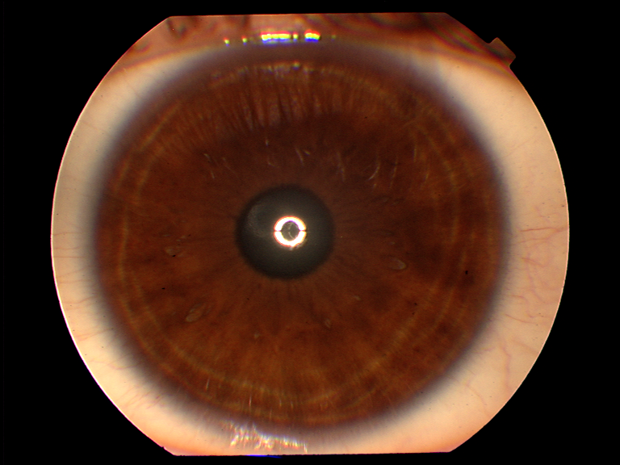
How Iris recognition works?
R
Ɵ
r
r
Ɵ
Pupil boundary
Iris boundary
Iris Image
Segmentation
Normalization

Slide 9
How Iris recognition works?
Gabor Filter
r
2048 bits Biometric data
Ɵ
Normalized Image
Extracted Features

Slide 10

Application: Registration
1. Public Key (K_{P})
Authenticator
2. Encrypts biometric data m, Enc _{Kp}(m)
3. Sends(Id, Enc(m))
to store
Cloud
User

Slide 11
Application: Authentication
Cloud
2. Encrypts Biometric data
m’, Enc _{Kp}(m’)
3. Sends (Id, Enc(m’)) to
Authenticate
7. Result of thresholding
4. Computes
(Id, E(m)xorE(m’)
User
1. Public Key (K_{P})
5. Sends XOR
Authenticator
6. Authenticator computes Dec(E(m)xorE(m’) = m xor m’,
using private key and performs thresholding

Slide 12
Appendix: RSA
RSA (Rivest, Shamir, Adleman)
It is deterministic encryption is based on the hardness of the factoring problem of the product of two large prime numbers.
KeyGen Algorithm:
large primes p and q, n = pq and ϕ = (p − 1)(q − 1) are computed.
e is chosen such that gcd (e,ϕ) = 1.
d is calculated by computing the multiplicative inverse of e (i.e., ed ≡1 mod ϕ) using extended euclidean algorithm.
Public key pair (e,n) and secret key pair (d,n).

Slide 13
Appendix:
RSA
Encryption Algorithm: First, the message is converted into a plaintext m such that 0 ≤ m < n, and then the RSA encryption algorithm is as follows:
c = E(m) = m^{e} (mod n), ∀m ∈ M, where c is the ciphertext.
Decryption Algorithm: The message m can be recovered from the ciphertext c using the secret key pair (d,n) as follows:
m = D(c) = c^{d} (mod n).

Slide 14
Appendix:
RSA
Homomorphic Property: For m1,m2 ∈ M,
E(m₁) ∗ E(m₂) = (m₁e (mod n)) ∗ (m₂e (mod n))
= (m₁ ∗m₂)^{e} (mod n)
= E(m₁ ∗m₂).
RSA is only homomorphic over multiplication. It does not allow the homomorphic addition of ciphertexts.
Return

Slide 15
Appendix: Paillier
Paillier (Pascal Paillier)
It is probabilistic encryption scheme based on the composite residuosity problem. The composite residuosity problem questions whether there exists an integer x such that x^{n} ≡ a (mod n²) for a given integer a.

Slide 16
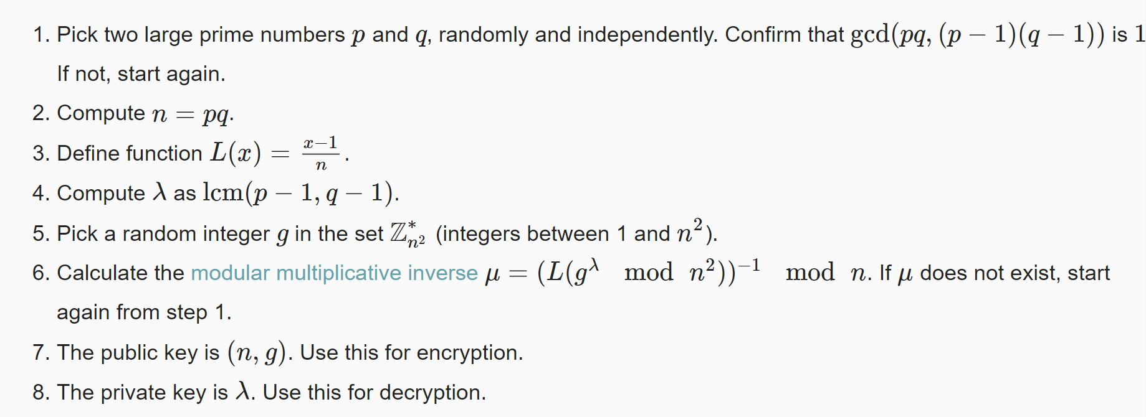
Appendix:
Paillier
KeyGen Algorithm:

Slide 17
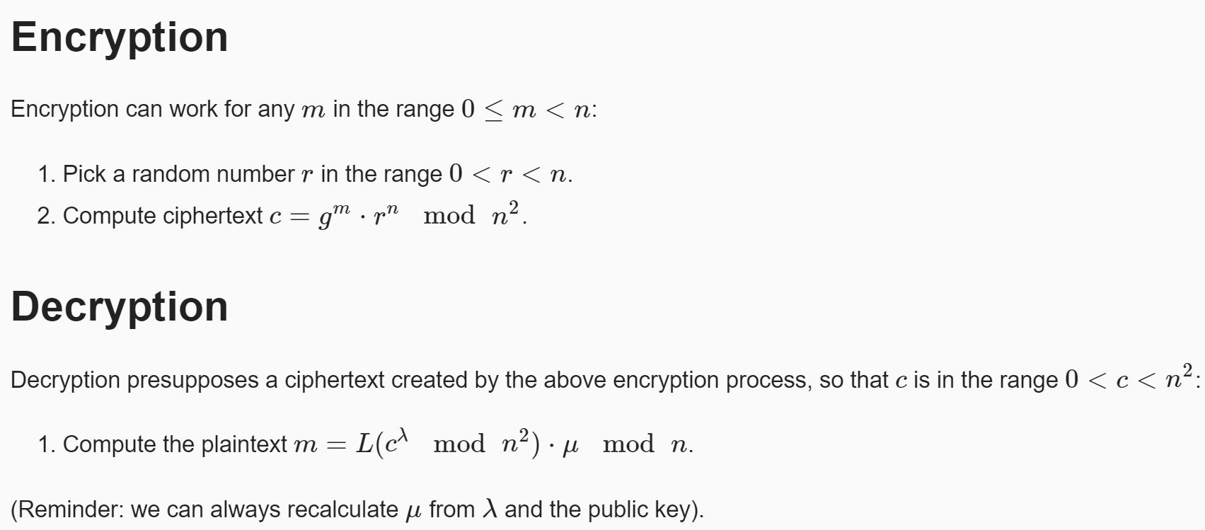
Appendix:
Paillier
Encryption Algorithm:
Decryption Algorithm:

Slide 18
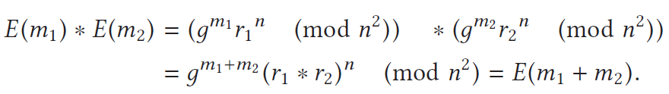
Appendix:
Paillier
Homomorphic Property:
This derivation shows that Pailliler’s encryption scheme is homomorphic over addition. In addition to homomorphism over the addition operation.
Return

Slide 19
Remapping the iris region from (x, y) Cartesian coordinates to normalize non- concentric polar representation (Homogeneous Rubber Sheet Model) is defined as:
I( x(r, Ɵ), y (r, Ɵ) ) → I(r, Ɵ) With
x(r, Ɵ) = (I - r)x_{p}(Ɵ) + rx_{I}(Ɵ)
y(r, Ɵ) = (I - r)y_{p}(Ɵ) + ry_{I}(Ɵ)
x_{p} , y_{p} and x_{I} , y_{I} are the coordinates of the pupil and iris boundaries along Ɵ direction
Return

